Slide 1

YOUTUBE SONG VIDEOS ANALYSIS WITH POWER Bi
Presented by
AZEEZ BABATUNDE ABIODUN
MIP-DA-10

Slide 2
PROBLEM STATEMENT
Youtube is one of the best streaming platform where artist and song writers upload their songs for people to access and appreciate their talents while they gain popularity and money from channel monetization.
The goal of this analysis is to utilize Power BI to create insightful visualizations and reports that provide a deeper understanding of YouTube songs' performance, popularity, and user engagement.
In this analysis, I aim to uncover trends, preferences, and patterns in the data to aid content creators and stakeholders in optimizing their YouTube song content.

Slide 3
Facts, findings and insights
Based on the provided data and analysis on the dataset, I was able to discover the following :
The song with the highest count of view has 2bn views.
The song with the lowest count of view has 0 views.
The total count of views accross all songs in the dataset is 230bn views.
The song with the highest count of likes has 13m likes.

Slide 4
Facts, findings and insights cont.d
The song with the lowest count of likes has 0 likes.
The total count of likes accross all song videos in the dataset is 2bn likes.
The song with the highest count of comments has 420k comments.
The song with the lowest count of comments has 0 comments.
The total count of comments accross all song videos in the dataset is 51m comments.
This shows that most viewers find it easy to just views and move on to the next video than to like and give comments about the videos even if they love it or not.

Slide 5
Facts, findings and insights cont.d
Only few song videos (about 1.05% of total dataset) were given caption during the time of upload.
['hindi songs', '2021 hindi songs', 'new hindi songs', '2021 new songs', 't-series', 'tseries', 'tseries songs', 'new song', 'hit songs 2021', '2021 film songs', 'bollywood songs', '2021 songs', 'hindi 2021 songs', 'film songs', 'hindi movie songs'] is the tag with the highest number of views with 6.89bn views and this is because the tag encompasses the artist, song name, country name, streaming channels, and few other latest tag as at such moments.
The most popular channel that upload song videos is T-Series
Song videos published between 12:00 - 1:00am has the highest number of views, likes and comments.

Slide 6
Facts, findings and insights cont.d
The hd definition videos has more views, likes and comments (about 85.6%) as compared with the sd definition videos with just 14.4% of the dataset.
The second quater Q2 has the highest count of views, likes and comments followed by fourth quater Q4 then Q3 and finally Q1 with the least count.
Videos published in the years 2011, 2018 and 2019 has the highest count of views, likes and comments.
Videos published in the month of May shows the record for the highest count of views, likes and comments.
The above data shows that latest trends and tags is one of the best ways to get user engagement on youtube, so it is advisable for every content creator to always add the trending hashtags while uploading their contents to gain more views, likes and comments.

Slide 7
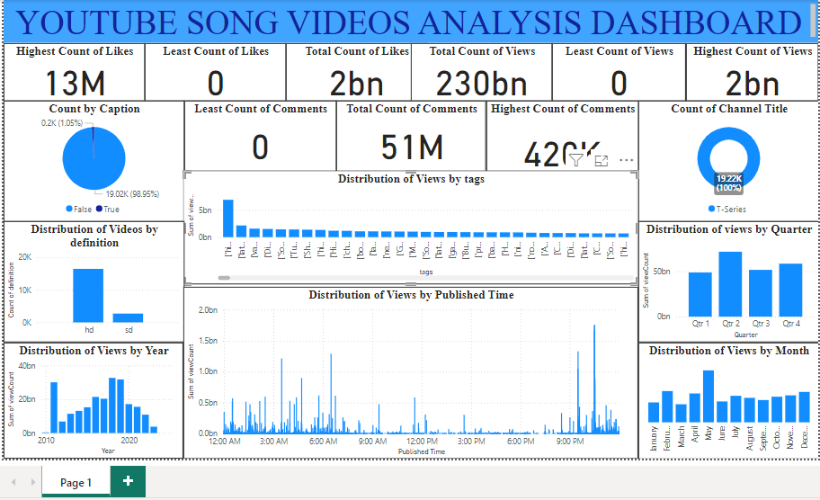
Dashboard

